Slide 1
Murach’s ASP.NET Core MVC (2nd Ed.)
Chapter 13
The Bookstore website

Slide 2
Objectives
Applied
Use any of the techniques presented in the Bookstore website.
Knowledge
Describe why it’s generally considered a good practice to have a “fat” model and “skinny” controllers.
Describe how the Author Catalog and Book Catalog pages provide for paging and sorting.
Describe how the Cart page uses session state and cookies to store its data.
Describe how the Manage Books tab of the Admin page prevents an author or genre from being deleted if it’s related to one or more books.

Slide 3
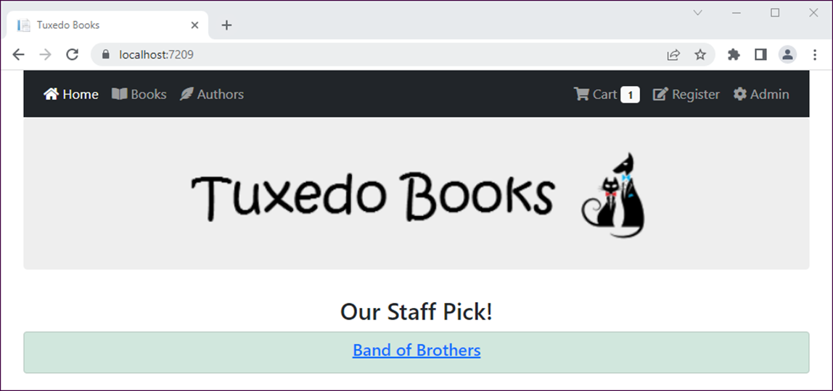
The Home page

Slide 4
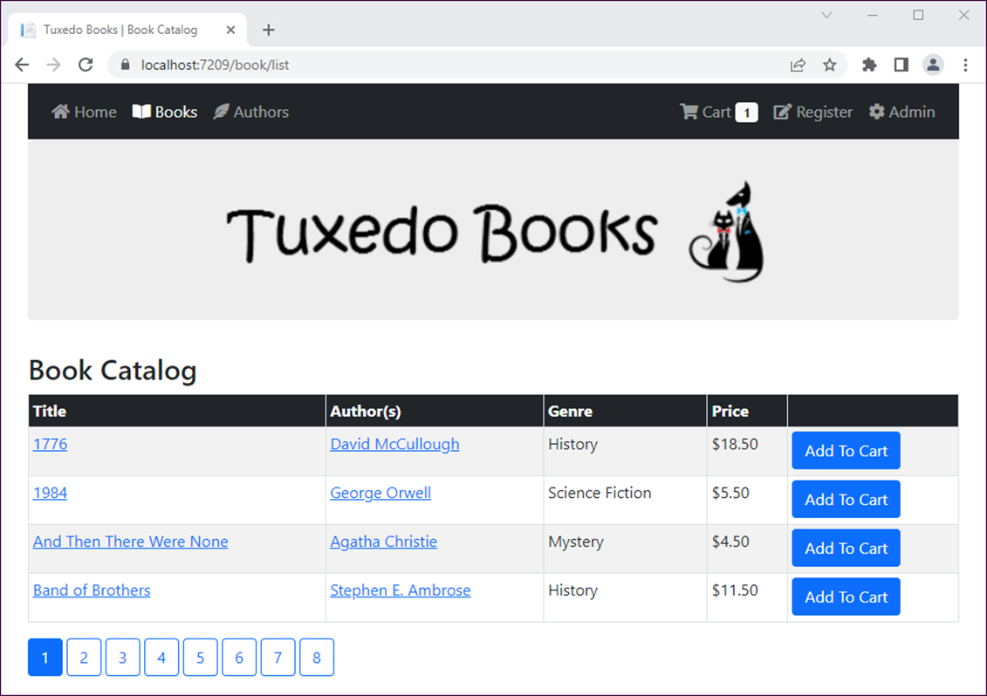
The Book Catalog page

Slide 5
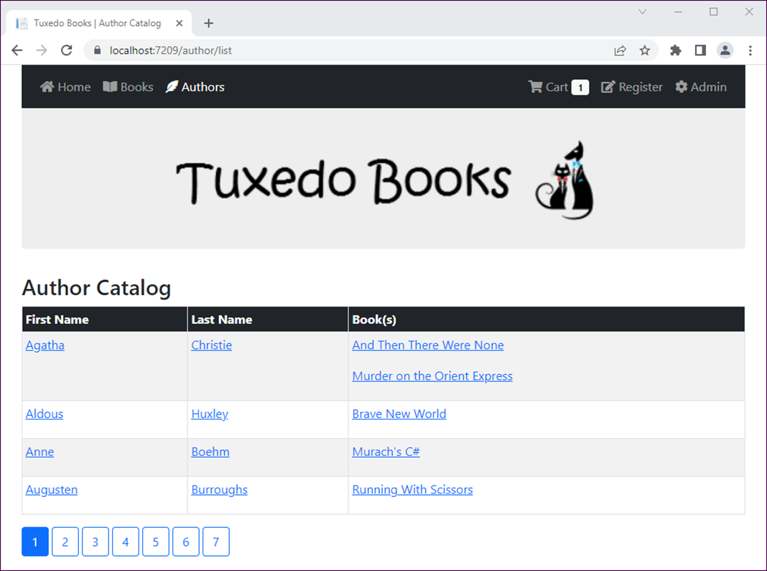
The Author Catalog page

Slide 6
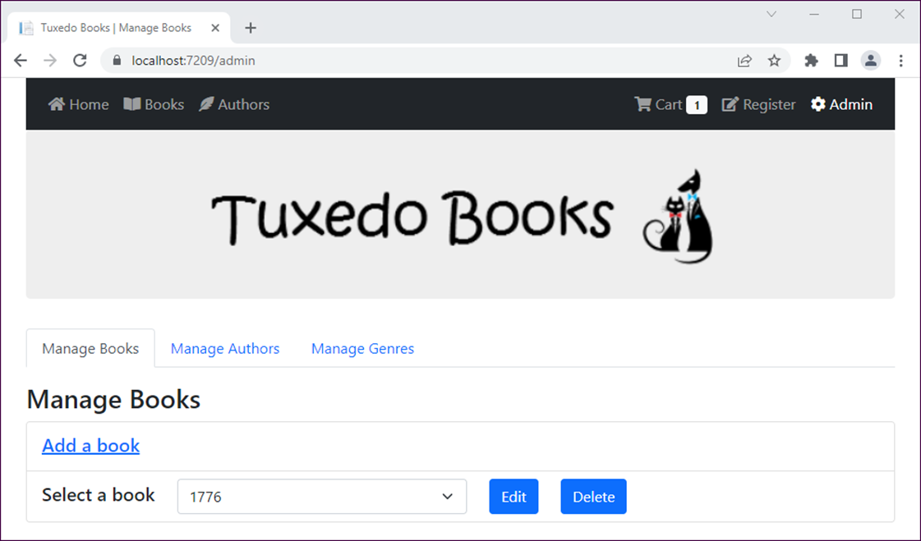
The Manage Books tab of the Admin page

Slide 7
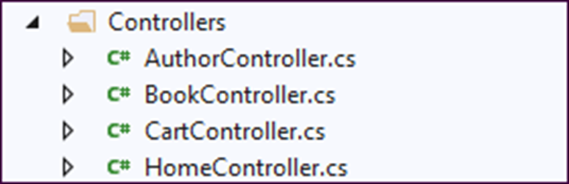
The Controllers folder

Slide 8
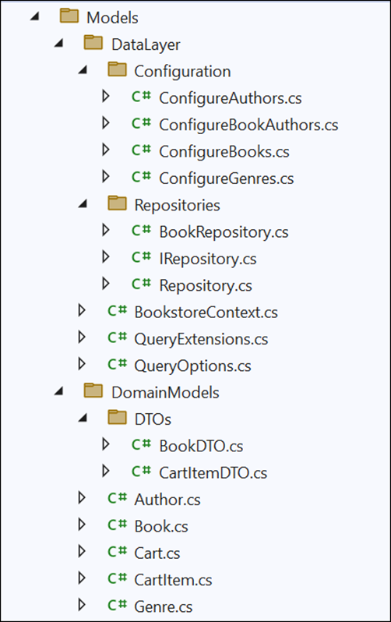
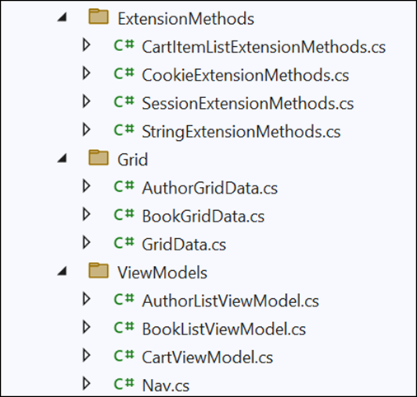
The Models folder and its subfolders

Slide 9
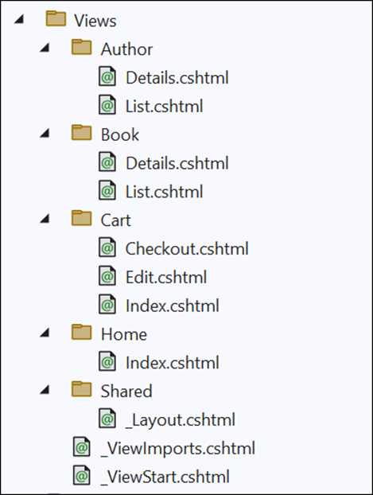
The Views folder

Slide 10
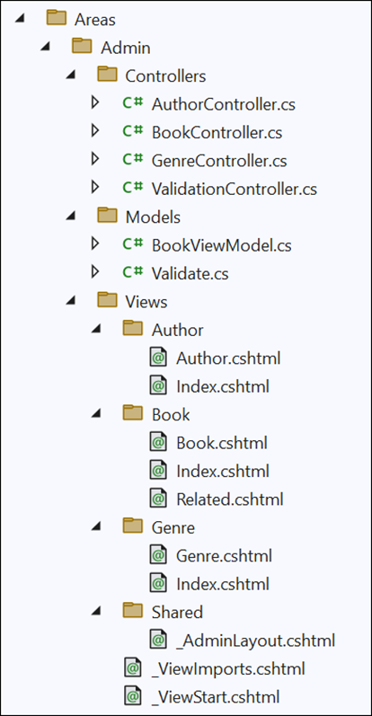
The Admin area folder and its subfolders

Slide 11
Extension methods for the String class
public static class StringExtensions
{
public static string Slug(this string str) {
var sb = new StringBuilder();
foreach (char c in str) {
if (!char.IsPunctuation(c) || c == '-') {
sb.Append(c);
}
}
return sb.ToString().Replace(' ', '-').ToLower();
}
public static bool EqualsNoCase(
this string str, string tocompare) =>
str?.ToLower() == tocompare?.ToLower();
public static int ToInt(this string str) {
int.TryParse(str, out int value);
return value;
}
public static string Capitalize(this string str) =>
str?.Substring(0, 1)?.ToUpper() +
str?.Substring(1).ToLower();
}

Slide 12
The generic QueryOptions class
public class QueryOptions<T>
{
public Expression<Func<T, Object>> OrderBy { get; set; }
= null!;
public Expression<Func<T, bool>> Where { get; set; } = null!;
public string OrderByDirection { get; set; } = "asc"; // default
public int PageNumber { get; set; }
public int PageSize { get; set; }
private string[] includes = Array.Empty<string>();
public string Includes {
set => includes = value.Replace(" ", "").Split(',');
}
public string[] GetIncludes() => includes;
// read-only properties
public bool HasWhere => Where != null;
public bool HasOrderBy => OrderBy != null;
public bool HasPaging => PageNumber > 0 && PageSize > 0;
}

Slide 13
The generic Repository class (part 1)
using Microsoft.EntityFrameworkCore;
...
public class Repository<T> : IRepository<T> where T : class
{
protected BookstoreContext context { get; set; }
private DbSet<T> dbset { get; set; }
public Repository(BookstoreContext ctx) {
context = ctx;
dbset = context.Set<T>();
}
public int Count => dbset.Count();
public virtual IEnumerable<T> List(QueryOptions<T> options) =>
BuildQuery(options).ToList();
public virtual T? Get(int id) => dbset.Find(id);
public virtual T? Get(string id) => dbset.Find(id);
public virtual T? Get(QueryOptions<T> options) =>
BuildQuery(options).FirstOrDefault();
public virtual void Insert(T entity) => dbset.Add(entity);
public virtual void Update(T entity) => dbset.Update(entity);
public virtual void Delete(T entity) => dbset.Remove(entity);
public virtual void Save() => context.SaveChanges();

Slide 14
The generic Repository class (part 2)
// private helper method to build query expression
private IQueryable<T> BuildQuery(QueryOptions<T> options)
{
IQueryable<T> query = dbset;
foreach (string include in options.GetIncludes()) {
query = query.Include(include);
}
if (options.HasWhere) {
query = query.Where(options.Where);
}
if (options.HasOrderBy) {
if (options.OrderByDirection == "asc")
query = query.OrderBy(options.OrderBy);
else
query = query.OrderByDescending(options.OrderBy);
}
if (options.HasPaging) {
query = query.PageBy(options.PageNumber, options.PageSize);
}
return query;
}
}

Slide 15
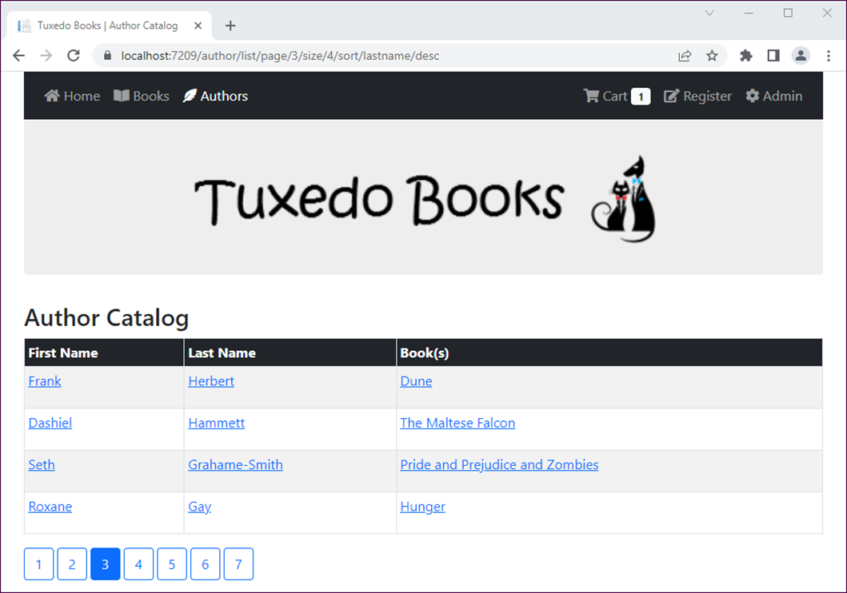
Page 3 of the Author Catalog sorted by last name in descending order

Slide 16
The URL for the Author Catalog page
https://localhost:7079/author/list/page/3/size/4/sort/
lastname/desc
The custom route in the Program.cs file
app.MapControllerRoute(
name: "page_sort",
pattern: "{controller}/{action}/
page/{pagenumber}/size/{pagesize}/
sort/{sortfield}/{sortdirection}");

Slide 17
The abstract GridData class (part 1)
public abstract class GridData
{
// properties for model binding the route segments
public int PageNumber { get; set; } = 1;
public int PageSize { get; set; } = 4;
public string SortDirection { get; set; } = "asc";
public string SortField { get; set; } = string.Empty;
public int GetTotalPages(int count) =>
(count + PageSize - 1) / PageSize;
public void SetSortAndDirection(string newSortField,
GridData current)
{
SortField = newSortField;
if (current.SortField.EqualsNoCase(newSortField) &&
current.SortDirection == "asc")
SortDirection = "desc";
else
SortDirection = "asc";
}

Slide 18
The abstract GridData class (part 2)
// make copy of self
public GridData Clone() => (GridData)MemberwiseClone();
public virtual Dictionary<string, string> ToDictionary() =>
new Dictionary<string, string> {
{ nameof(PageNumber), PageNumber.ToString() },
{ nameof(PageSize), PageSize.ToString() },
{ nameof(SortField), SortField },
{ nameof(SortDirection), SortDirection },
};
}

Slide 19
The AuthorGridData subclass
using System.Text.Json.Serialization;
...
public class AuthorGridData : GridData
{
// set initial sort field in constructor
public AuthorGridData() =>
SortField = nameof(Author.FirstName);
[JsonIgnore]
public bool IsSortByFirstName =>
SortField.EqualsNoCase(nameof(Author.FirstName));
}

Slide 20
The Author/List view model
public class AuthorListViewModel
{
public IEnumerable<Author> Authors { get; set; } =
new List<Author>();
public AuthorGridData CurrentRoute { get; set; } =
new AuthorGridData();
public int TotalPages { get; set; }
}

Slide 21
The Author controller (part 1)
public class AuthorController : Controller
{
private Repository<Author> data { get; set; }
public AuthorController(BookstoreContext ctx) =>
data = new Repository<Author>(ctx);
public IActionResult Index() => RedirectToAction("List");
public ViewResult List(AuthorGridData values)
{
var options = new QueryOptions<Author> {
Includes = "Books",
PageNumber = values.PageNumber,
PageSize = values.PageSize,
OrderByDirection = values.SortDirection,
};
if (values.IsSortByFirstName)
options.OrderBy = a => a.FirstName;
else
options.OrderBy = a => a.LastName;

Slide 22
The Author controller (part 2)
var vm = new AuthorListViewModel {
Authors = data.List(options),
CurrentRoute = values,
TotalPages = values.GetTotalPages(data.Count)
};
return View(vm);
}
public IActionResult Details(int id)
{
var author = data.Get(new QueryOptions<Author> {
Where = a => a.AuthorId == id,
Includes = "Books"
}) ?? new Author();
return View(author);
}
}

Slide 23
The Author/List view (part 1)
@model AuthorListViewModel
@{
ViewData["Title"] = " | Author Catalog";
AuthorGridData current = Model.CurrentRoute;
GridData routes = Model.CurrentRoute.Clone();
}
<h1>Author Catalog</h1>
<table class="table table-bordered table-striped table-sm">
<thead class="bg-dark text-white">
<tr>
<th>
@{ routes.SetSortAndDirection(nameof(Author.FirstName),
current); }
<a asp-action="List"
asp-all-route-data="@routes.ToDictionary()"
class="text-white">First Name</a></th>
<th>
@{ routes.SetSortAndDirection(nameof(Author.LastName),
current); }
<a asp-action="List"
asp-all-route-data="@routes.ToDictionary()"
class="text-white">Last Name</a></th>
<th>Books(s)</th>
</tr>
</thead>

Slide 24
The Author/List view (part 2)
<tbody>
@foreach (Author author in Model.Authors) {
<tr>
<td>
<a asp-action="Details" asp-route-id="@author.AuthorId"
asp-route-slug="@author.FullName.Slug()">@author.FirstName</a>
</td>
<td>
<a asp-action="Details" asp-route-id="@author.AuthorId"
asp-route-slug="@author.FullName.Slug()">@author.LastName</a>
</td>
<td>
@foreach (var ba in author.BookAuthors) {
<p>
<a asp-action="Details" asp-controller="Book"
asp-route-id="@ba.BookId"
asp-route-slug="@ba.Book.Title.Slug()">@ba.Book.Title</a></p>
}
</td>
</tr>
}
</tbody>
</table>

Slide 25
The Author/List view (part 3)
@{
routes = current.Clone(); // reset to current route values
for (int i = 1; i <= Model.TotalPages; i++) {
routes.PageNumber = i;
string active = @Nav.Active(i, current.PageNumber);
<a asp-action="List" asp-all-route-data="@routes.ToDictionary()"
class="btn btn-outline-primary @active">@i</a>
}
}

Slide 26
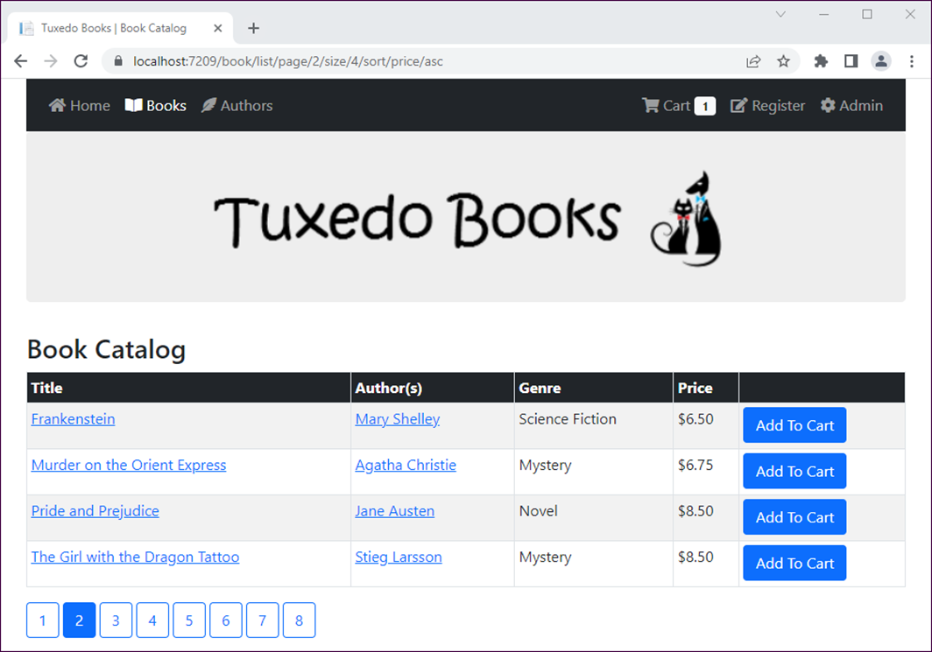
Page 2 of the Book Catalog sorted by price in ascending order

Slide 27
The URL for the Book Catalog page
https://localhost:7079/book/list/page/2/size/4/
sort/price/asc
The custom route in the Program.cs file
app.MapControllerRoute(
name: "page_sort",
pattern: "{controller}/{action}/
page/{pagenumber}/size/{pagesize}/
sort/{sortfield}/{sortdirection}");

Slide 28
The BookGridData subclass
using System.Text.Json.Serialization;
...
public class BookGridData : GridData
{
// set initial sort field in constructor
public BookGridData() =>
SortField = nameof(Book.Title);
// sort flags
[JsonIgnore]
public bool IsSortByGenre =>
SortField.EqualsNoCase(nameof(Genre));
[JsonIgnore]
public bool IsSortByPrice =>
SortField.EqualsNoCase(nameof(Book.Price));
}

Slide 29
The Book/List view model
public class BookListViewModel
{
public IEnumerable<Book> Books { get; set; } =
new List<Book>();
public BookGridData CurrentRoute { get; set; } =
new BookGridData();
public int TotalPages { get; set; }
}

Slide 30
The Book controller (part 1)
public class BookController : Controller
{
Repository<Book> data { get; set; }
public BookController(BookstoreContext ctx) =>
data = new Repository<Book>(ctx);
public RedirectToActionResult Index() =>
RedirectToAction("List");
public ViewResult List(BookGridData values)
{
var options = new QueryOptions<Book> {
Includes = "Authors, Genre",
OrderByDirection = values.SortDirection,
PageNumber = values.PageNumber,
PageSize = values.PageSize
};

Slide 31
The Book controller (part 2)
if (values.IsSortByGenre)
options.OrderBy = b => b.GenreId;
else if (values.IsSortByPrice)
options.OrderBy = b => b.Price;
else
options.OrderBy = b => b.Title;
var vm = new BookListViewModel {
Books = data.List(options),
CurrentRoute = values,
TotalPages = values.GetTotalPages(data.Count)
};
return View(vm);
}
public ViewResult Details(int id)
{
var book = data.Get(new QueryOptions<Book> {
Where = b => b.BookId == id,
Includes = "Authors, Genre"
}) ?? new Book();
return View(book);
}
}

Slide 32
The Book/List view (part 1)
@model BookListViewModel
@{
ViewData["Title"] = " | Book Catalog";
BookGridData current = Model.CurrentRoute;
GridData routes = Model.CurrentRoute.Clone();
}
<h1>Book Catalog</h1>
@* add to cart form *@
<form asp-action="Add" asp-controller="Cart" method="post">
<table class="table table-bordered table-striped table-sm">
<thead class="bg-dark text-white">
<tr>
<th>
@{ routes.SetSortAndDirection(
nameof(Book.Title), current); }
<a asp-action="List"
asp-all-route-data="@routes.ToDictionary()"
class="text-white">Title</a>
</th>

Slide 33
The Book/List view (part 2)
<th>Author(s)</th>
<th>
@{ routes.SetSortAndDirection(
nameof(Genre), current); }
<a asp-action="List"
asp-all-route-data="@routes.ToDictionary()"
class="text-white">Genre</a>
</th>
<th>
@{ routes.SetSortAndDirection(
nameof(Book.Price), current); }
<a asp-action="List"
asp-all-route-data="@routes.ToDictionary()"
class="text-white">Price</a>
</th>
<th></th>
</tr>
</thead>

Slide 34
The Book/List view (part 3)
<tbody>
@foreach (Book book in Model.Books) {
<tr>
<td>
<a asp-action="Details"
asp-route-id="@book.BookId"
asp-route-slug="@book.Title.Slug()">
@book.Title
</a>
</td>
<td>
@foreach (var a in book.Authors) {
<p>
<a asp-action="Details"
asp-controller="Author"
asp-route-id="@a.AuthorId"
asp-route-slug=
"@a.FullName.Slug()">
@a.FullName
</a>
</p>
}
</td>

Slide 35
The Book/List view (part 4)
<td>@book.Genre.Name</td>
<td>@book.Price.ToString("c")</td>
<td>
<button type="submit" name="id"
value="@book.BookId"
class="btn btn-primary">
Add To Cart
</button>
</td>
</tr>
}
</tbody>
</table>
</form>

Slide 36
The Book/List view (part 5)
@* paging links *@
@{
routes = current.Clone(); // reset to current route values
for (int i = 1; i <= Model.TotalPages; i++)
{
routes.PageNumber = i;
string active = @Nav.Active(i, current.PageNumber);
<a asp-action="List"
asp-all-route-data="@routes.ToDictionary()"
class="btn btn-outline-primary @active">@i</a>
}
}

Slide 37
Extension methods for the ISession interface
using System.Text.Json;
...
public static class SessionExtensions
{
public static void SetObject<T>(
this ISession session, string key, T value) =>
session.SetString(key, JsonSerializer.Serialize(value));
public static T? GetObject<T>(this ISession session, string key)
{
var value = session.GetString(key);
return (value == null) ? default(T) :
JsonSerializer.Deserialize<T>(value);
}
}

Slide 38
Extension methods for cookies (part 1)
using System.Text.Json;
...
public static class CookieExtensions
{
public static string GetString(
this IRequestCookieCollection cookies, string key) =>
cookies[key] ?? string.Empty;
public static int? GetInt32(
this IRequestCookieCollection cookies, string key) {
var value = cookies.GetString(key);
return int.TryParse(value, out int i) ? i : (int?)null;
}
public static T? GetObject<T>(
this IRequestCookieCollection cookies, string key) {
var value = cookies.GetString(key);
return value == null ? default(T) :
JsonSerializer.Deserialize<T>(value);
}

Slide 39
Extension methods for cookies (part 2)
public static void SetString(this IResponseCookies cookies,
string key, string value, int days = 30) {
cookies.Delete(key); // delete old value first
if (days == 0) { // session cookie
cookies.Append(key, value);
} else { // persistent cookie
CookieOptions options = new CookieOptions {
Expires = DateTime.Now.AddDays(days)
};
cookies.Append(key, value, options);
}
}
public static void SetInt32(this IResponseCookies cookies,
string key, int value, int days = 30) =>
cookies.SetString(key, value.ToString(), days);
public static void SetObject<T>(this IResponseCookies cookies,
string key, T value, int days = 30) =>
cookies.SetString(key, JsonSerializer.Serialize(value),
days);
}

Slide 40
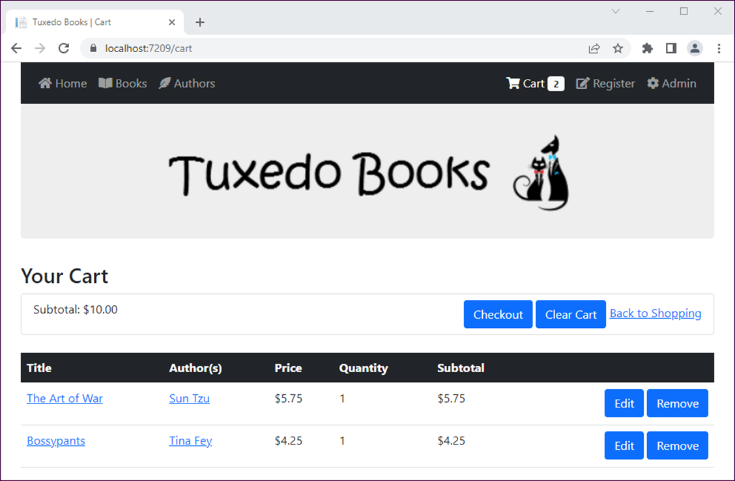
The Cart page

Slide 41
The CartItem class
using System.Text.Json.Serialization;
...
public class CartItem
{
public BookDTO Book { get; set; } = new BookDTO();
public int Quantity { get; set; }
[JsonIgnore]
public double Subtotal => Book.Price * Quantity;
}

Slide 42
The BookDTO class
public class BookDTO
{
public int BookId { get; set; }
public string Title { get; set; } = string.Empty;
public double Price { get; set; }
public Dictionary<int, string> Authors { get; set; } =
new Dictionary<int, string>();
// default constructor (required for model binding)
public BookDTO() { }
// overloaded constructor accepts a Book object
public BookDTO(Book book)
{
BookId = book.BookId;
Title = book.Title;
Price = book.Price;
if (book.Authors?.Count > 0) {
foreach (Author a in book.Authors) {
Authors.Add(a.AuthorId, a.FullName);
}
}
}
}

Slide 43
The CartItemDTO class
public class CartItemDTO
{
public int BookId { get; set; }
public int Quantity { get; set; }
}

Slide 44
An extension method for a list of CartItem objects
public static class CartItemListExtensions
{
public static List<CartItemDTO> ToDTO(
this List<CartItem> list) =>
list.Select(ci => new CartItemDTO {
BookId = ci.Book.BookId,
Quantity = ci.Quantity
}).ToList();
}

Slide 45
The CartViewModel class
public class CartViewModel
{
public IEnumerable<CartItem> List { get; set; } =
new List<CartItem>();
public double Subtotal { get; set; }
}

Slide 46
The Cart class (part 1)
public class Cart
{
private const string CartKey = "mycart";
private const string CountKey = "mycount";
private List<CartItem> items { get; set; } = null!;
private List<CartItemDTO> cookieItems { get; set; } = null!;
private ISession session { get; set; }
private IRequestCookieCollection requestCookies { get; set; }
private IResponseCookies responseCookies { get; set; }
public Cart(HttpContext ctx)
{
session = ctx.Session;
requestCookies = ctx.Request.Cookies;
responseCookies = ctx.Response.Cookies;
}

Slide 47
The Cart class (part 2)
public void Load(Repository<Book> data)
{
items = session.GetObject<List<CartItem>>(CartKey)
?? new List<CartItem>();
cookieItems = requestCookies.GetObject<List<CartItemDTO>>(CartKey)
?? new List<CartItemDTO>();
if (cookieItems.Count > items.Count) {
items.Clear(); // clear any previous session data
foreach (CartItemDTO storedItem in cookieItems) {
var book = data.Get(new QueryOptions<Book> {
Where = b => b.BookId == storedItem.BookId,
Includes = "Authors, Genre"
});
// skip if book is null - no longer in database
if (book != null) {
CartItem item = new CartItem {
Book = new BookDTO(book),
Quantity = storedItem.Quantity
};
items.Add(item);
}
}
Save();
}
}

Slide 48
The Cart class (part 3)
public double Subtotal => items.Sum(i => i.Subtotal);
public int? Count => session.GetInt32(CountKey) ??
requestCookies.GetInt32(CountKey);
public IEnumerable<CartItem> List => items;
public CartItem? GetById(int? id) {
if (items == null || id == null) {
return null;
} else {
return items.FirstOrDefault(
ci => ci.Book?.BookId == id);
}
}
public void Add(CartItem item) {
var itemInCart = GetById(item.Book.BookId);
if (itemInCart == null) { // if new, add
items.Add(item);
}
else { // otherwise, increase quantity by 1
itemInCart.Quantity += 1;
}
}

Slide 49
The Cart class (part 4)
public void Edit(CartItem item) {
var itemInCart = GetById(item.Book.BookId);
if (itemInCart != null) {
itemInCart.Quantity = item.Quantity;
}
}
public void Remove(CartItem item) => items.Remove(item);
public void Clear() => items.Clear();
public void Save() {
if (items.Count == 0) {
session.Remove(CartKey);
session.Remove(CountKey);
responseCookies.Delete(CartKey);
responseCookies.Delete(CountKey);
}
else {
session.SetObject<List<CartItem>>(CartKey, items);
session.SetInt32(CountKey, items.Count);
responseCookies.SetObject<List<CartItemDTO>>(
CartKey, items.ToDTO());
responseCookies.SetInt32(CountKey, items.Count);
}
}
}

Slide 50
The Cart controller (part 1)
public class CartController : Controller
{
private Repository<Book> data { get; set; }
public CartController(BookstoreContext ctx) =>
new Repository<Book>(ctx);
private Cart GetCart()
{
var cart = new Cart(HttpContext);
cart.Load(data);
return cart;
}
public ViewResult Index()
{
Cart cart = GetCart();
var vm = new CartViewModel
{
List = cart.List,
Subtotal = cart.Subtotal
};
return View(vm);
}

Slide 51
The Cart controller (part 2)
[HttpPost]
public RedirectToActionResult Add(int id)
{
var book = data.Get(new QueryOptions<Book> {
Where = b => b.BookId == id,
Includes = "Authors, Genre"
});
if (book == null){ // book not in database
TempData["message"] = "Unable to add book to cart.";
}
else {
CartItem item = new CartItem {
Book = new BookDTO(book),
Quantity = 1 // default value
};
Cart cart = GetCart();
cart.Add(item);
cart.Save();
TempData["message"] = $"{book.Title} added to cart";
}
return RedirectToAction("List", "Book");
}

Slide 52
The Cart controller (part 3)
[HttpPost]
public RedirectToActionResult Remove(int id)
{
Cart cart = GetCart();
CartItem? item = cart.GetById(id);
if (item != null)
{
cart.Remove(item);
cart.Save();
TempData["message"] =
$"{item.Book.Title} removed from cart.";
}
return RedirectToAction("Index");
}

Slide 53
The Cart controller (part 4)
[HttpPost]
public RedirectToActionResult Clear()
{
Cart cart = GetCart();
cart.Clear();
cart.Save();
TempData["message"] = "Cart cleared.";
return RedirectToAction("Index");
}
[HttpGet]
public IActionResult Edit(int id)
{
Cart cart = GetCart();
CartItem? item = cart.GetById(id);
if (item == null) {
TempData["message"] = "Unable to locate cart item";
return RedirectToAction("Index");
}
else {
return View(item);
}
}

Slide 54
The Cart controller (part 5)
[HttpPost]
public RedirectToActionResult Edit(CartItem item)
{
Cart cart = GetCart();
cart.Edit(item);
cart.Save();
TempData["message"] = $"{item.Book.Title} updated";
return RedirectToAction("Index");
}
public ViewResult Checkout() => View();
}

Slide 55
The Cart/Index view (part 1)
@model CartViewModel
...
<h1>Your Cart</h1>
<form asp-action="Clear" method="post">
<ul class="list-group mb-4">
<li class="list-group-item">
<div class="row">
<div class="col">Subtotal: @Model.Subtotal.ToString("c")
</div>
<div class="col">
<div class="float-end">
<a asp-action="Checkout" class="btn btn-primary">
Checkout</a>
<button type="submit" class="btn btn-primary">
Clear Cart</button>
<a asp-action="List" asp-controller="Book">
Back to Shopping</a>
</div>
</div>
</div>
</li>
</ul>
</form>

Slide 56
The Cart/Index view (part 2)
<form asp-action="Remove" method="post">
<table class="table">
<thead class="bg-dark text-white">
<tr><th>Title</th>
<th>Author(s)</th>
<th>Price</th>
<th>Quantity</th>
<th>Subtotal</th>
<th></th>
</tr>
</thead>
<tbody>
@foreach (CartItem item in Model.List) {
<tr>
<td>
<a asp-action="Details" asp-controller="Book"
asp-route-id="@item.Book.BookId"
asp-route-slug="@item.Book.Title.Slug()">
@item.Book.Title
</a>
</td>

Slide 57
The Cart/Index view (part 3)
<td>
@foreach (var pair in item.Book.Authors) {
<p><a asp-action="Details"
asp-controller="Author"
asp-route-id="@pair.Key"
asp-route-slug="@pair.Value.Slug()">
@pair.Value</a>
</p>
}
</td>
<!-- cells that display price, quantity, subtotal -->
<td>
<div class="float-end">
<a asp-action="Edit" asp-controller="Cart"
asp-route-id="@item.Book.BookId"
asp-route-slug="@item.Book.Title.Slug()"
class="btn btn-primary">Edit</a>
<button type="submit" name="id"
value="@item.Book.BookId"
class="btn btn-primary">Remove</button>
</div></td></tr>
}
</tbody>
</table>
</form>

Slide 58
The IBookRepository interface
public interface IBookRepository : IRepository<Book>
{
void AddUpdateAuthors(Book book, int[] authorids,
IRepository<Author> authorData);
}

Slide 59
The BookRepository class
public class BookRepository : Repository<Book>, IBookRepository
{
public BookRepository(BookstoreContext ctx) : base(ctx) { }
public void AddUpdateAuthors(Book book, int[] authorids,
IRepository<Author> authorData)
{
// first remove any current authors
foreach (Author author in book.Authors)
{
book.Authors.Remove(author);
}
// then add new authors
foreach (int id in authorids)
{
Author? author = authorData.Get(id);
if (author != null)
book.Authors.Add(author);
}
}
}

Slide 60
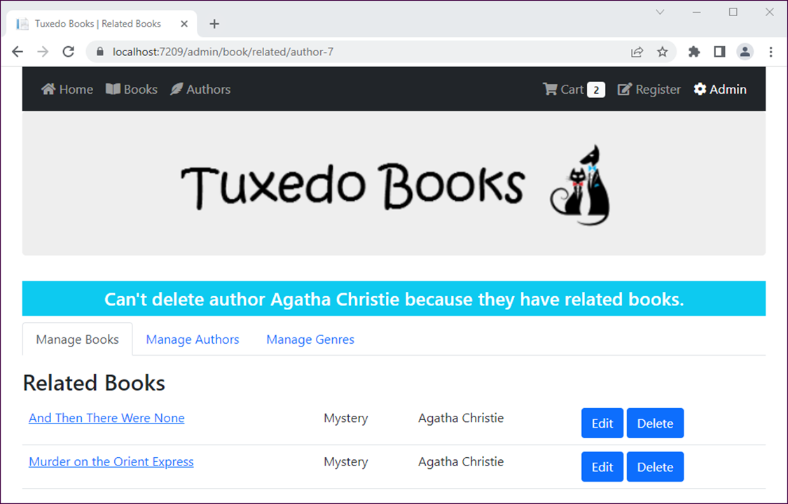
The view when a user tries to delete an author that has books

Slide 61
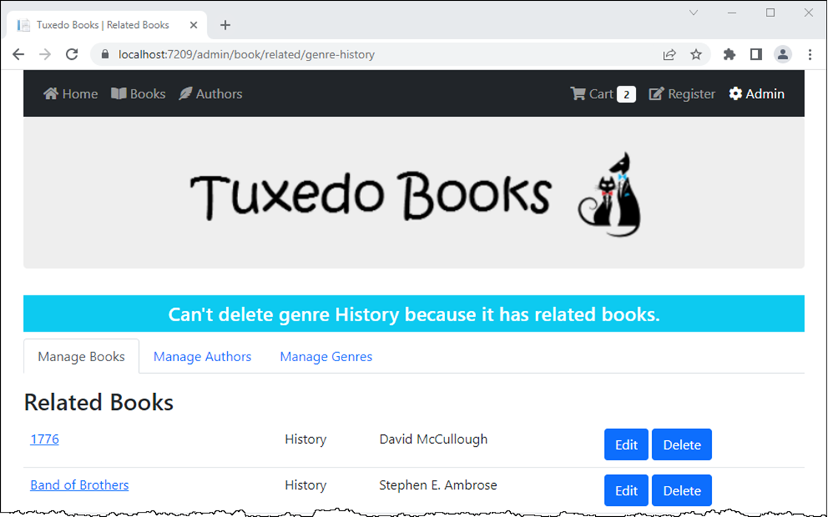
The view when a user tries to delete a genre that has books

Slide 62
The Delete() action method of the Author controller for GET requests
[HttpGet]
public IActionResult Delete(int id)
{
var author = data.Get(new QueryOptions<Author> {
Where = a => a.AuthorId == id,
Includes = "Books"
});
if (author != null && author.Books.Count > 0) {
TempData["message"] =
$"Can't delete author {author.FullName} " +
"because they have related books.";
return RedirectToAction("Related", "Book",
new { id = "author-" + id });
}
else { return View("Author", author); }
}

Slide 63
The Delete() action method of the Genre controller for GET requests
[HttpGet]
public IActionResult Delete(string id)
{
var genre = data.Get(new QueryOptions<Genre> {
Where = g => g.GenreId == id,
Includes = "Books"
});
if (genre != null && genre.Books.Count > 0) {
TempData["message"] =
$"Can't delete genre {genre.Name} " +
"because it has related books.";
return RedirectToAction("Related", "Book",
new { id = "genre-" + id });
}
else { return View("Genre", genre); }
}

Slide 64
The Related() action method of the Book controller
public ViewResult Related(string id)
{
var parts = id.Split('-');
string type = parts[0];
id = parts[1];
var options = new QueryOptions<Book> {
OrderBy = b => b.Title,
Includes = "Authors, Genre"
};
if (type.EqualsNoCase("author"))
options.Where = b => b.Authors.Any( ba => ba.AuthorId == id.ToInt());
else if (type.EqualsNoCase("genre"))
options.Where = b => b.GenreId.ToLower() == id;
return View(bookData.List(options));
}

